Slide 1
Crosslist for FIRST survey and nearest galaxies
And Learn note VLA pipeline
Lv Bing

Slide 3
The FIRST survey covers two regions: North: RA = ~8h to ~17h, Dec = -8° to +64° South: RA = 21h20m to 3h20m, Dec = -2.5° to +1.6°

Slide 4
List of FIRST survey and nearest galaxies
(num: 946432,126)

Slide 5
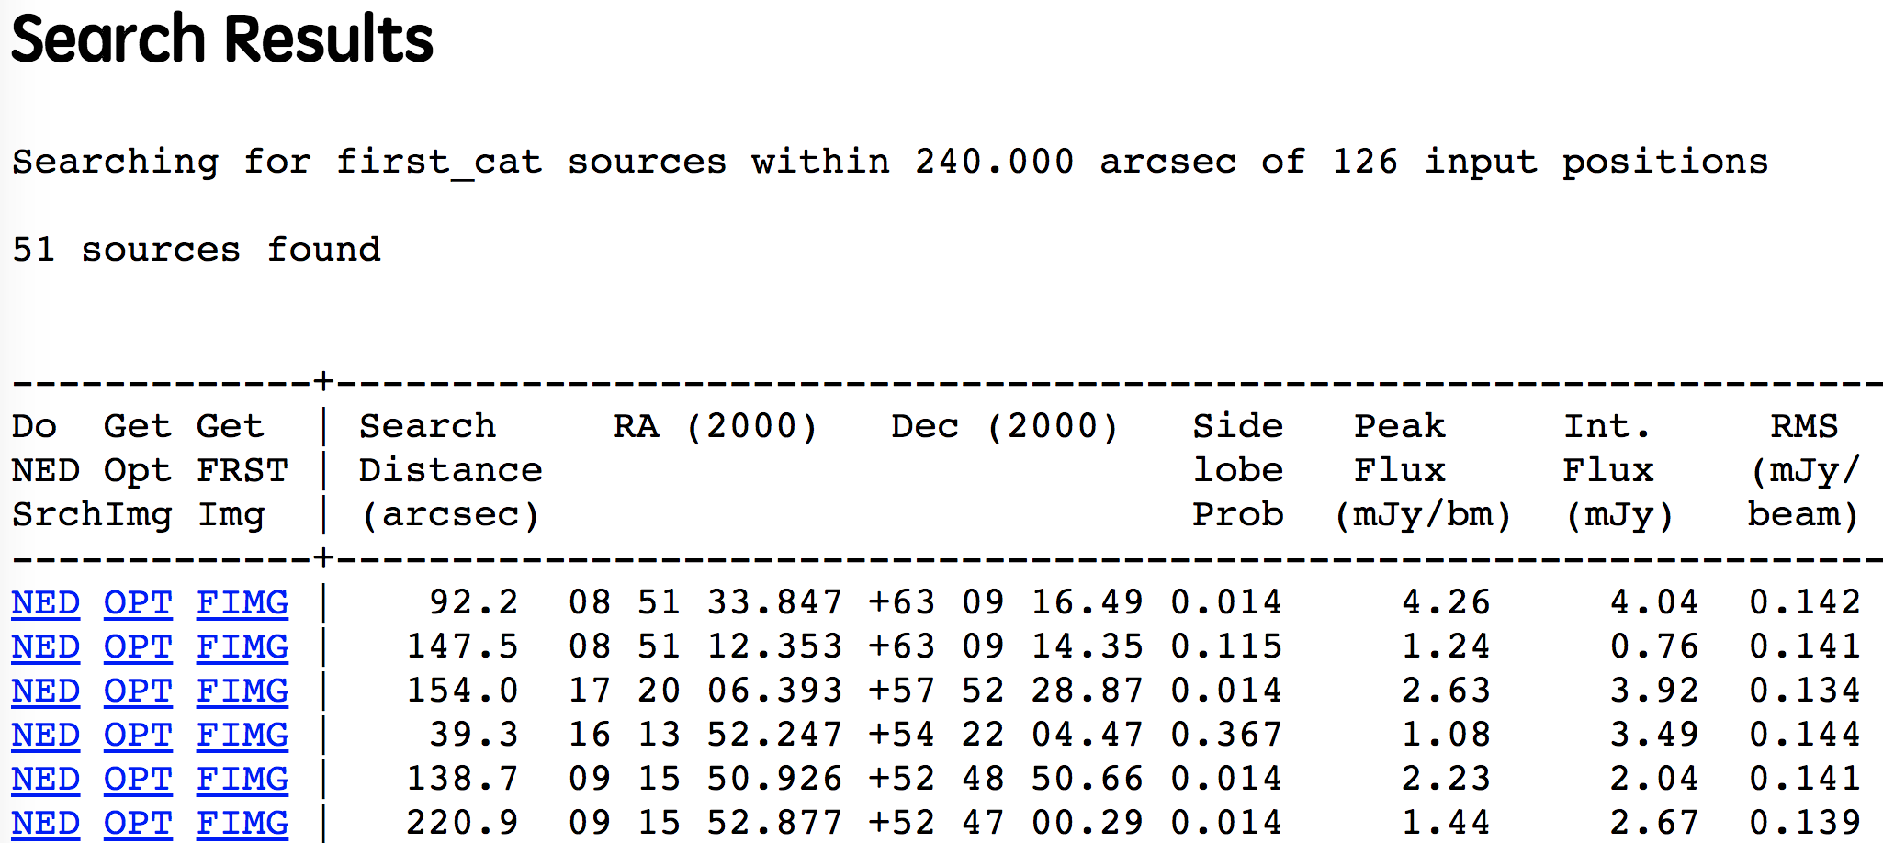

Slide 6
Extract FIRST Image Cutouts

Slide 7
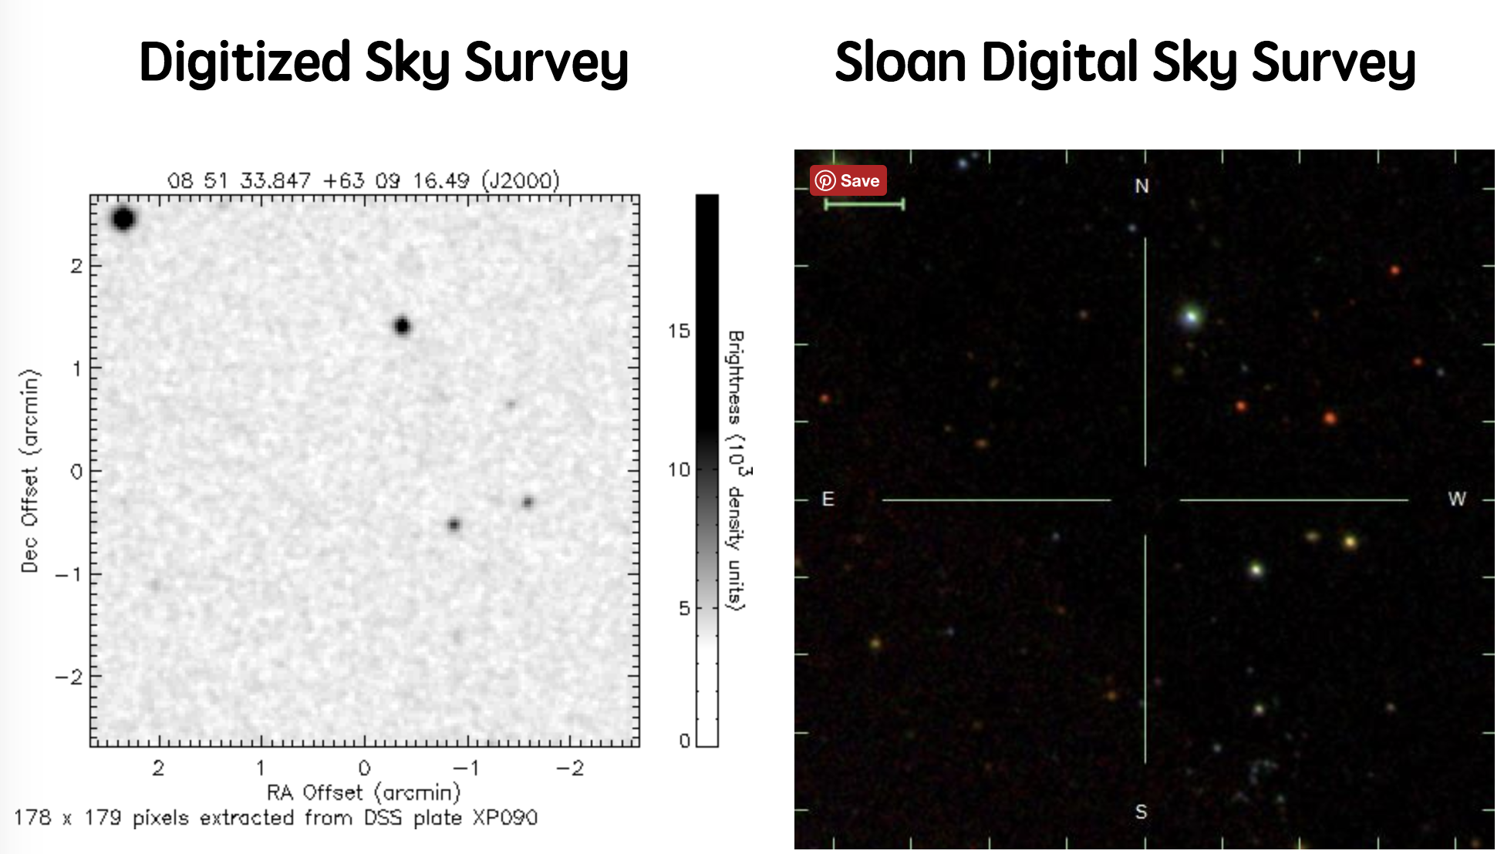
Extract Optical DSS/SDSS Images

Slide 8
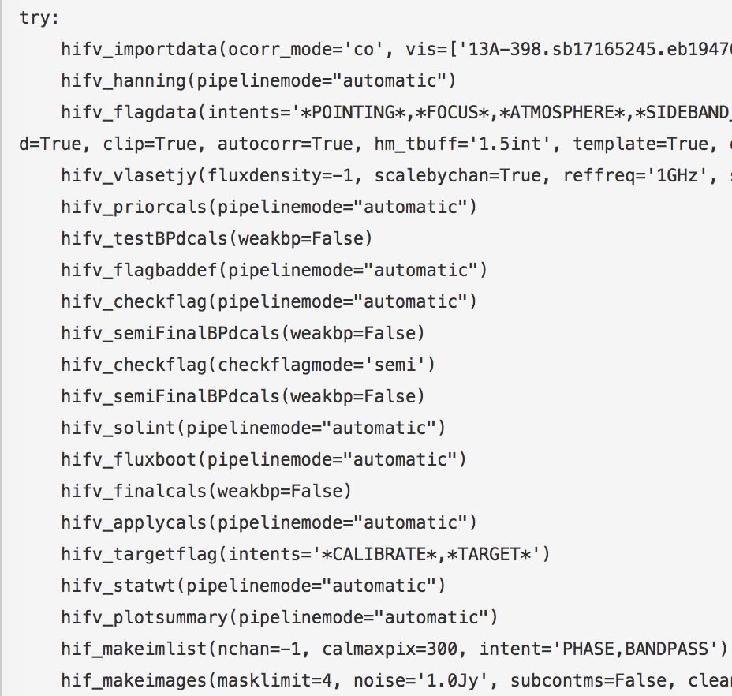
Casa pipeline procedure

Slide 9
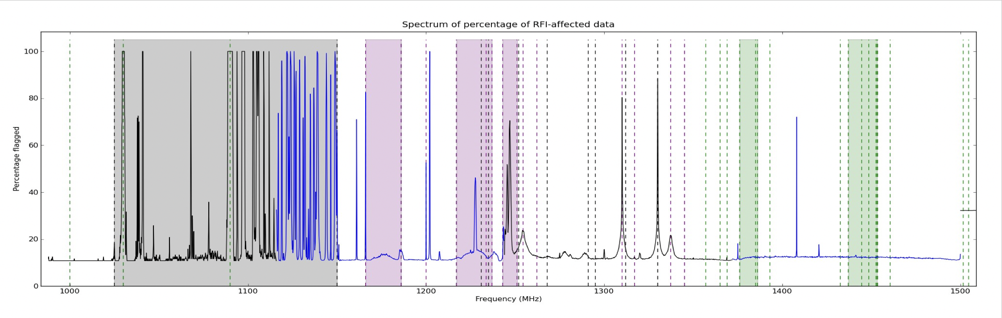
RFI remove
Radio Frequency Interference : Terrestrial, Satellites, etc..
At L-Band, can use ~500 MHz with very rough flagging, ~800 MHz if done carefully.
RFI is less at higher frequencies. At X-band and beyond, RFI is minimal

Slide 10
Online + Deterministic Flags
– slew, subreflector error, focus error – operator logs of known bad antennas and time-ranges
– shadowing between antennas (elevation-dependent)
– exact zeros (from the correlator) – known frequency ranges with bad RFI
Flagging Tasks - flagdata + flagcmd

Slide 11
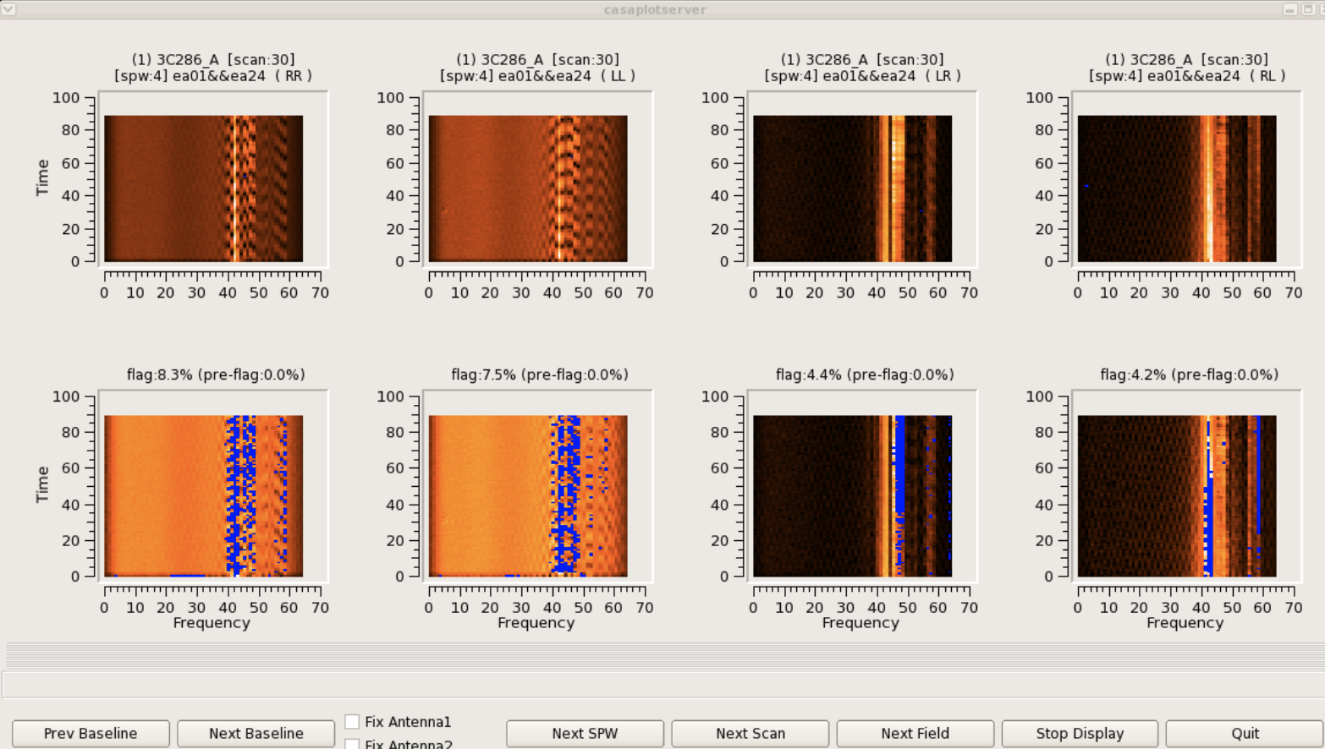
example

Slide 12
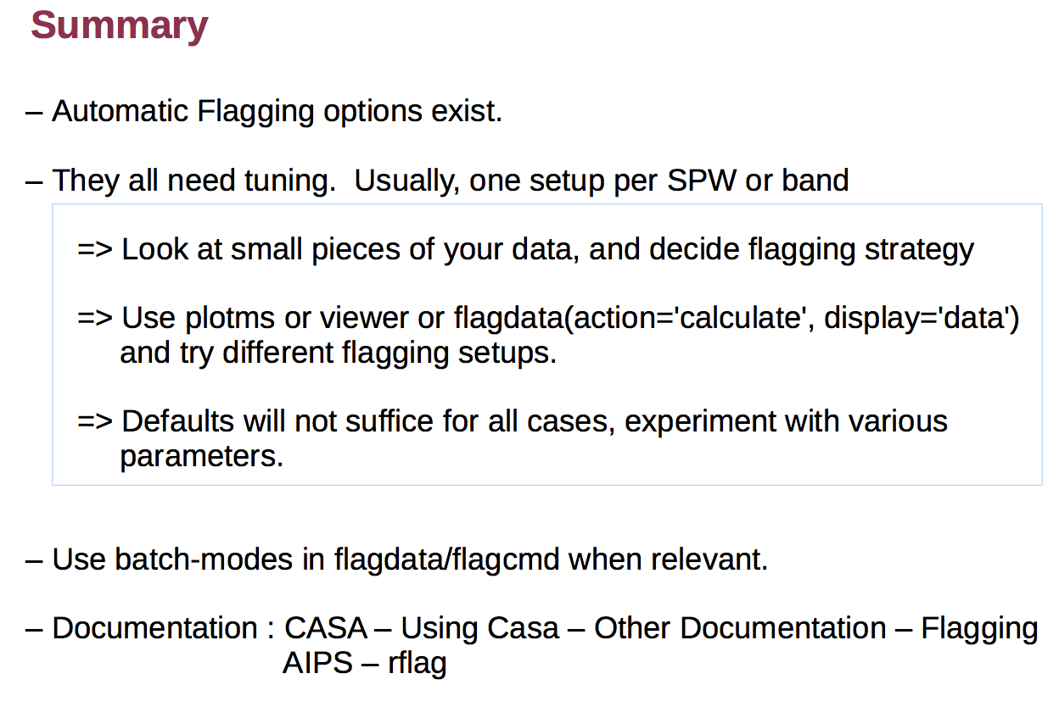

Slide 13
Next
Details for RFI and single source reduction of VLA data
Chandra list?
ciao tutorial…
And all of notes can be accessible at
http://nbviewer.jupyter.org/github/brettlv/brettlv.github.io/tree/master/radiolearnnote/
and
http://nbviewer.jupyter.org/github/brettlv/brettlv.github.io/tree/master/pythoncode/

